Slide 1
prepositions

Slide 2
introduction
Prepositions: a word that describes where or when something is
Example of objects it can be used for: Clock, pen, desk, chair, book, pencil, notebook, wall, computer, phone, lamp, TV, refrigerator, pillows, blanket, window, carpet

Slide 3
Examples: on, in, under, above, next to, behind, below
Can you think of any other examples of words that describe where or when something is?

Slide 4
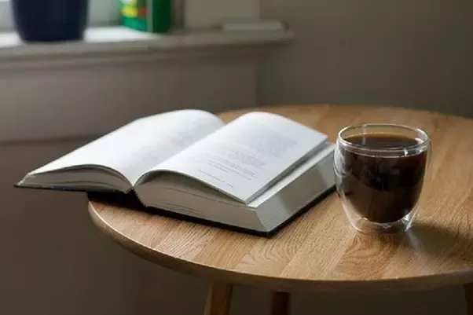
Example 1
The book is on the table.
The cup is on the table.
The book is next to the cup.
The cup is next to the book.

Slide 5
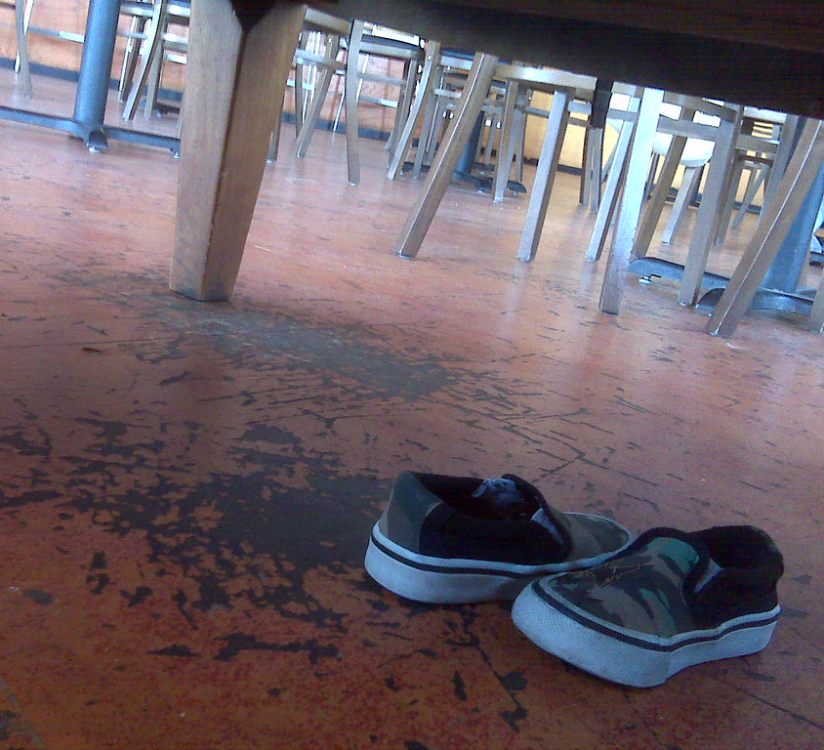
Example 2
- The shoes are under the table.
- The table is above the shoes.

Slide 6
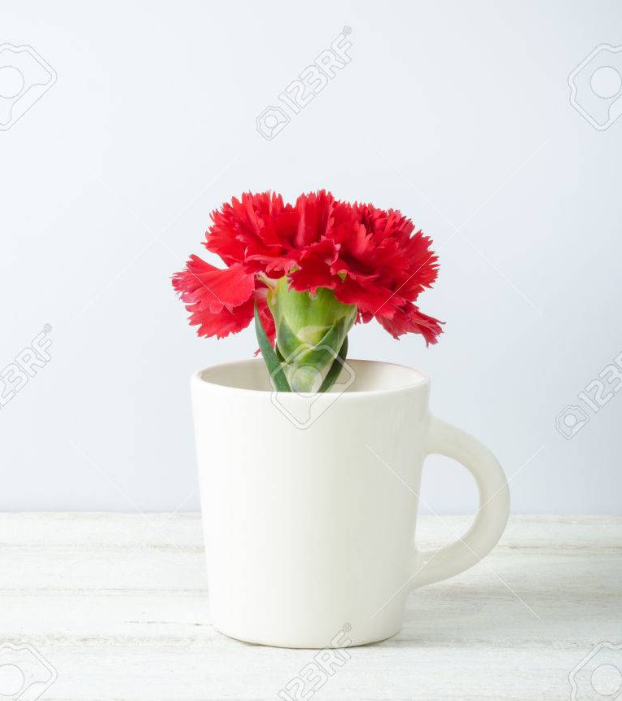
Example 3
The flower is in the cup.
The cup is on the table.
The flower in the cup is on the table.

Slide 7
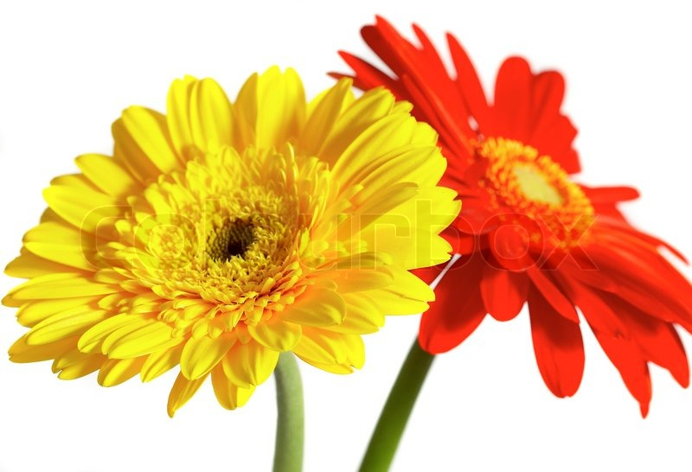
Example 4
The red flower is next to the yellow flower.
The yellow flower is next to the red flower.

Slide 8
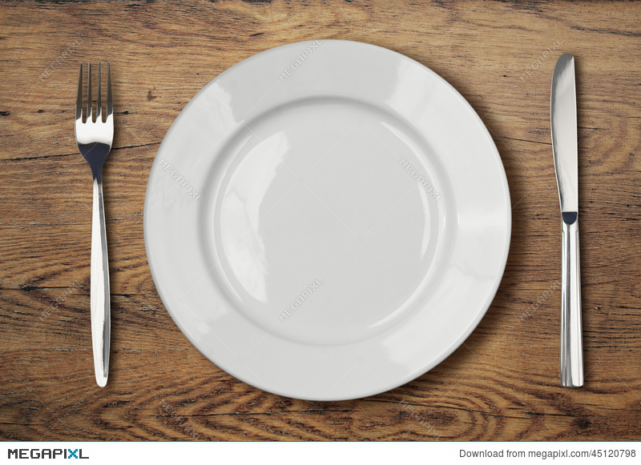
Example 5
The plate is on the table.
The plate, fork, and knife are on the table.
The fork is next to the plate.
The knife is next to the plate.
The fork and knife are next to the plate.

Slide 9
video
https://www.youtube.com/watch?v=idJYhjGyWTU

Slide 10
practice
https://www.grammarbank.com/prepositions-exercises.html

Slide 11
homework
Write 5 sentences using different prepositions.

Slide 12
You did great today ☺

